Slide 1
Project
Project Title- Amharic Language IR System Tsegay Assefa UGR/3204/16 Department of Information Sciences Sec-2 College of Natural and Computational Sciences June 11, 2025

Slide 2
Outline
Introduction
Purpose of the Project
System Architecture
Text Preprocessing
Statistical Analysis and Zipf’s Law
Indexing and Luhn’s Idea
Indexing File(inverted file)
Retrieval Model (VSM)
Graphical User Interface
Evaluation
Applications
Challenges and Solutions

Slide 3
Introduction
Amharic IR System is a mini IR system designed to process and retrieve Amharic text documents using the Vector Space Model (VSM)
Language: Amharic, Ethiopia’s official language, uses Fidel script with rich morphology
Objective: Address lack of Amharic-specific IR tools for efficient document retrieval
Features: Preprocessing, indexing, statistical analysis (Zipf’s law), user-friendly GUI

Slide 4
Why This System is Needed
Lack of Tools - Most IR systems target English, neglecting Amharic’s script and morphology
Information Overload - Growing digital Amharic content (news, books) requires efficient search
Linguistic Challenges - Rich morphology and limited resources hinder processing
Statistical Insights - Zipf’s law helps analyze corpus and optimize retrieval

Slide 5
System Architecture
Components
Text Preprocessing
Frequency Analysis and Zipf’s Law
Index Term Selection (Luhn’s Idea)
Inverted Indexing
Retrieval with VSM (TF-IDF, Cosine Similarity)
GUI for Query Input
Corpus - 17 Amharic documents (AmharicBook1.txt to AmharicBook17.txt)
Tools - Python 3.9, BeautifulSoup, NumPy, scikit-learn, Matplotlib, Tkinter

Slide 6
Text Preprocessing
Markup Removal: Extracts plain text using BeautifulSoup; preserves Amharic Unicode
Normalization: Standardizes spelling, removes non-Amharic text
Tokenization: Splits text on spaces and separators (e.g., ፡)
Stopword Removal: Filters 300–400 stopwords from file
Stemming: Rule-based stemming for prefixes/suffixes

Slide 7
Statistical Analysis
Computes the frequency of each term across the corpus using collections.Counter
Generates a frequency dictionary, saved as Output/frequency.xlsx, showing word counts, ranks, and normalized frequencies.
The rank-frequency plot indicates a Zipfian distribution, with the average rank-frequency product stabilizing around a constant value

Slide 8
Frequency Analysis and Zipf’s Law
Purpose - Understand term distribution in the corpus
Zipf’s law states few terms dominate, many are rare
Implementation: collections.Counter for frequencies
Output - Frequency table (Excel), Zipf plot (PNG)
Zipf’s Law - Confirms Amharic texts follow power-law behavior

Slide 9
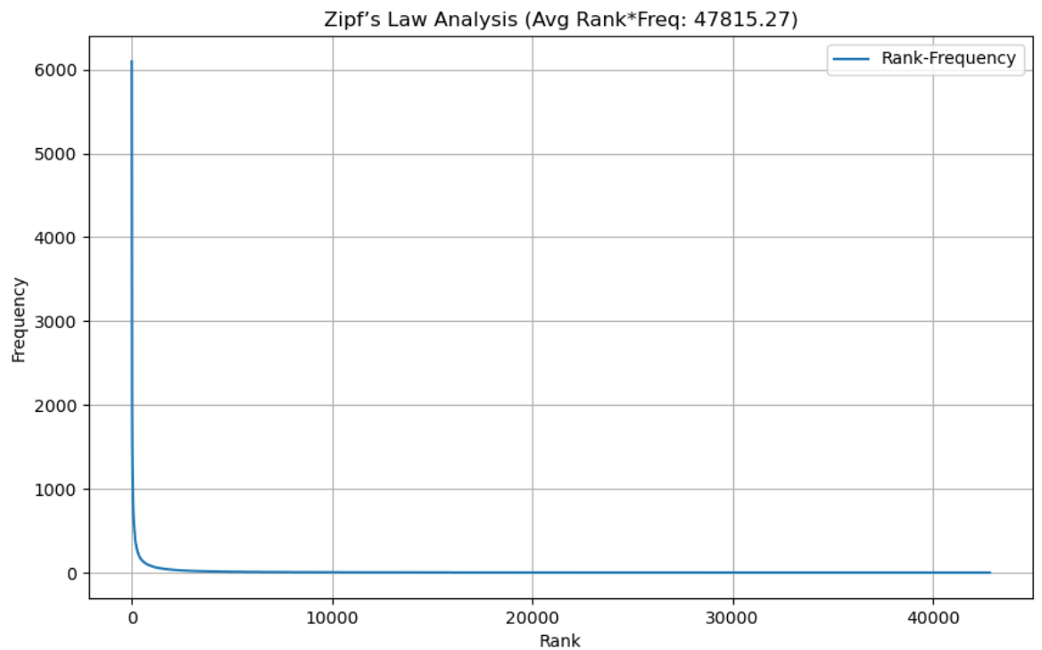
Zipf plot image

Slide 10
Index Term Selection Using Luhn’s Idea
Filters very frequent/rare terms (indexing.py).
Upper Cut-off: Top 3%.
Lower Cut-off: frequency of term<3 in docs
Luhn’s Idea: mid-frequency terms are discriminative and keep them.
Outputs: Index/index_terms.txt

Slide 11
Indexing File
Inverted Index - Maps terms to documents with TF weights.
inverted index’s helps in quick searching.
Structure - term → {doc_id: TF} (indexing.py).
Files - inverted_index.json, term_frequencies.json.
Output: index_terms.txt, vocabulary.json, postings.json

Slide 12
Retrieval Model(VSM)
Model - Vector Space Model with TF-IDF and cosine similarity
Process:
Convert query/documents to TF-IDF vectors
Compute cosine similarity
Ranks documents by query relevance
Evaluation
Measuring System Performance
Precision, recall, F1-score using scikit-learn

Slide 13
Graphical User Interface
User-Friendly Search Interface
Tool - Built with Tkinter
Uses Nyala font for Amharic text
Features:
Amharic query input
Input validation
Results display with scores

Slide 14
Real-World Applications
Education - Search Amharic textbooks.
Media - Retrieve news articles.
Government - Access Amharic records.
Digital archives -Scalable to large digital archives
Applicable in libraries

Slide 15
Challenges and Solutions
Limited Resources:
Challenge: Few stopword lists or stemmers
Solution: Custom stopwords, rule-based stemmer
Morphology:
Challenge: Over-/under-stemming
Solution: Affix removal with validation
Unicode Issues:
Challenge: Encoding inconsistencies
Solution: Enforced UTF-8, Nyala font
Small Corpus:
Challenge: Only 17 docs
Solution: Designed for scalability

Slide 16
Tools Used
Python 3.9, libraries: beautifulsoup4, numpy, tkinter.
Environment: VS Code, Anaconda.
Inputs: stopwords.txt, Input corpus.
Outputs: frequency.xlsx, inverted_index.json.
Python, VS Code, Anaconda.
Folder for inputs, file for outputs

Slide 17
Conclusion
Built Amharic IR system using VSM + TF-IDF + cosine similarity
Handled linguistic challenges with custom preprocessing
Verified Zipf’s law on Amharic corpus
Future Work: Improve stemming, add query expansion, scale to 1,000+ docs
Impact: Foundation for Amharic IR in academia and archiving

Slide 18
Acknowledgement
Special thanks to Instructor Adey for inspiring me to do this project.
Gratitude to AAU for institutional resources and tools(wifi..)
Appreciation for open-source tools (Python, libraries)
END
Thank you!
Questions?

